Slide 1

Which one follows the possessive adjective?
My
Your
Our
Their
His
Her
its
?
NOUN

Slide 2
Which one is before the noun?
?
adjective
NOUN

Slide 3
Which one follows and modifies the verb?
?
Verb
adverb

Slide 4
Which one follows “to be”?
?
To be
adjective

Slide 5

- ocean (n)
→ oceanic (a)

Slide 6

- accommodate (v)
→ accommodation (n)

Slide 7

- fly (v)
→ flight (n)

Slide 8

- day (n)
→ daily (a)

Slide 9

- mountain (n)
→ mountainous (a)

Slide 10

- tribe (n)
→ tribal (a)

Slide 11

- beauty (n)
→ beautiful (a)

Slide 12

Ha Long Bay is recognized by UNESCO as a World Heritage Site.
- recognize (v)
→ recognition (n)

Slide 13

- variety (n)
→ various (n)

Slide 15



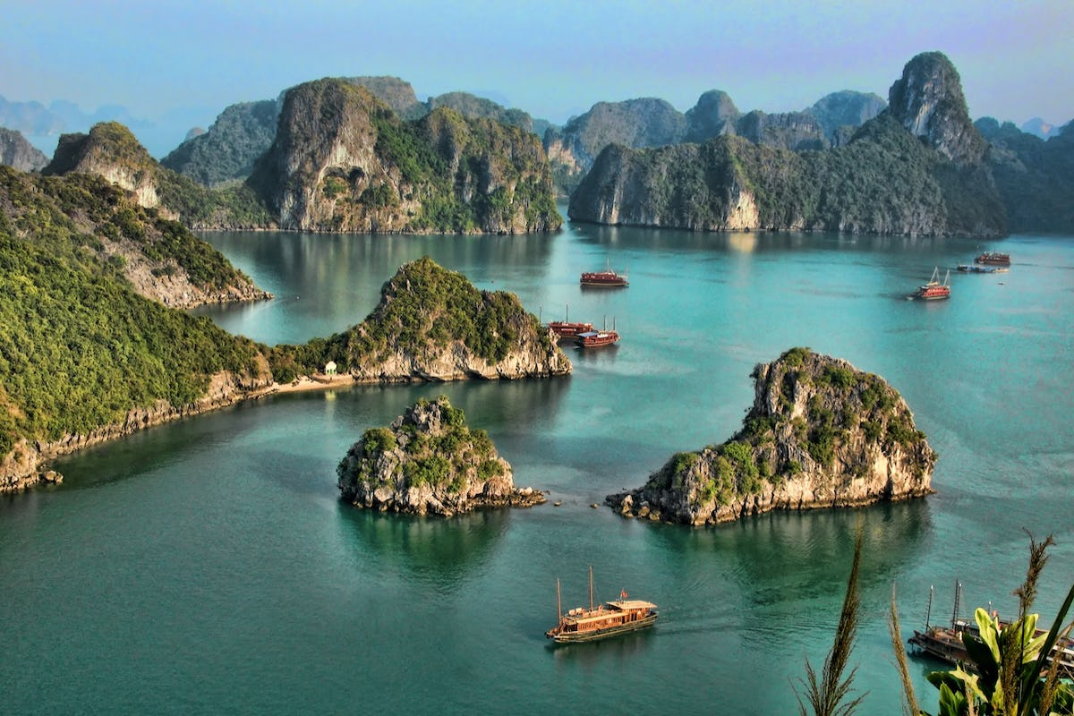
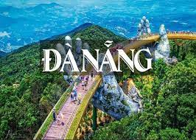

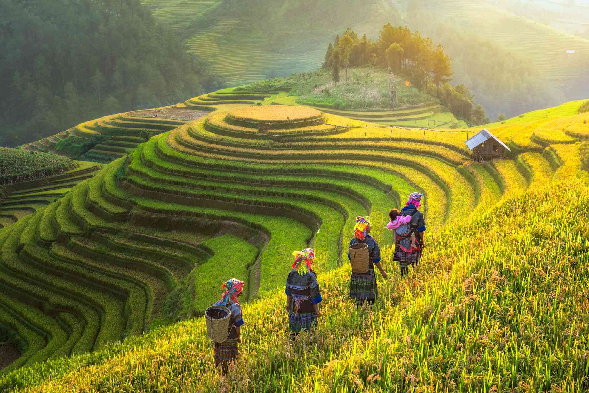
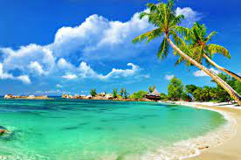
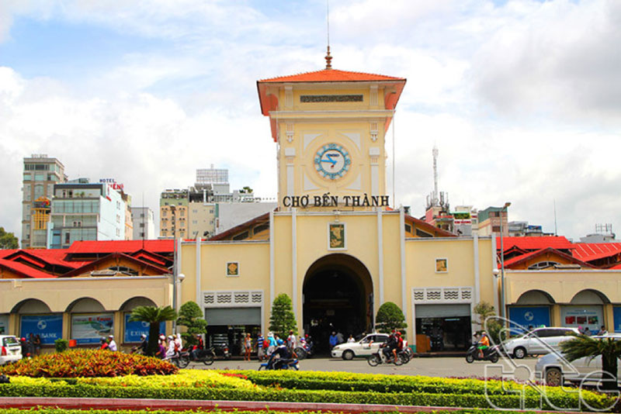
LUCKY WHEEL
Exchange another group’s points
30
- 10
20
Lose points
Ha Long Bay
Da Nang
40
X 2
Steal another group’s points
Sa Pa
Start
Phan Thiet
Ben Thanh market

Slide 16

There is a big, well-know _____institute in Nha Trang.
A. sea
B. marine
C. ocean
D. oceanic
D. oceanic

Slide 17
Do you often read a ________newspaper?
A. daily
A. daily
B. day
C. dayly
D. date

Slide 18
Sapa has many _______mountainous resorts.
A. beautiful
B. beautifully
B. beautifully
C. beauty
D. beautifuly

Slide 19
There are lots of hotels and _____islands in Ha Long.
A. variety
B. vary
C. various
C. various
D. variation

Slide 20
I didn’t ______her voice at the first time.
A. recognizable
B. recognition
C. recognizably
D. recognize
D. recognize

Slide 21

Give the correct form of word
1. It’s difficult to find ____________ at busy time. (accommodate)
2. Sapa is a famous__________ resort in Vietnam. (mountain)
3. Every week, there are two ________ from Ho Chi Minh City to Dalat. (fly)
4. These tourists want to visit an ____________ institute in Nha Trang. (ocean)
5. Most tourists like visiting ________villages.
(tribe)
accommodation
mountainous
flights
oceanic
tribal

Slide 22
HOMEWORK
Learn by heart new words.
Prepare next lesson: Language focus

